Slide 1
AZ-100.1 Managing Azure Subscriptions and Resources V2

Slide 2
Course Agenda
M01: Managing Azure Subscriptions
L01: Overview of Azure Subscriptions
L02: Billing
L03: Azure Policy
M02: Access Management for Cloud Resources
L01: Azure Users and Groups
L02: Role-based Access Control
M03: Monitoring and Diagnostics
L01: Exploring Monitoring Capabilities in Azure
L02: Azure Alerts
L03: Azure Activity Logs

Slide 3
Course Agenda (continued)
M04: Log Analytics
L01: Introduction to Log Analytics
L02: Querying and Analyzing Log Analytics Data
M05: Azure Resource Manager
L01: ARM Templates
L02: Resource Groups
M06: Azure Tips, Tricks, and Tools
L01: The Azure Portal
L02: Azure Tools and Environment

Slide 4
Cloud Administrator Role
Cloud Administrators manage the cloud services that span storage, networking and compute cloud capabilities, with a deep understanding of each service across the full IT lifecycle.
They take end-user requests for new cloud applications and make recommendations on services to use for optimal performance and scale, as well as provision, capacity, monitor and adjust as appropriate. This role requires communicating and coordinating with vendors.
Cloud Administrators use the Azure Portal and as they become more proficient they use PowerShell and the Command Line Interface.
Successful Cloud Administrators start this role with experience on operating systems, virtualization, cloud infrastructure, storage structures, and networking.

Slide 5
Certification Areas (AZ-100)
Study Areas | Weights
Manage Azure subscriptions and resources | 15-20%
Implement and manage storage | 20-25%
Deploy and manage virtual machines | 20-25%
Configure and manage virtual networks | 20-25%
Manage identities | 15-20%
Percentages indicate the relative weight of each area on the exam
The higher the percentage, the more questions you are likely to see in that area
Notes:
AZ-100 Certification Areas - https://www.microsoft.com/en-us/learning/exam-az-100.aspx

Slide 6
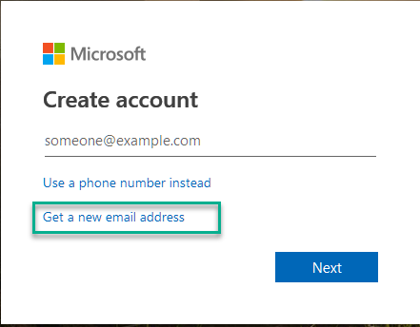
Redeem Azure Pass voucher
Create a new email address and Live Id
Create here https://signup.live.com/
It is recommend students use nametraining@outlook.com (bobtraining@outlook.com) which will be used for the duration of the class.
If this is your second Azure class just make it nametraining2@outlook.com and so on.
2. After your email account is created go to URL https://www.microsoftazurepass.com to begin the step-by-step redemption process.

Slide 7
Lab 0: Optional Install Windows 10 VM
If you are unable to install apps on your PC then you can create one to do some or all of the labs in.

Slide 8
AZ-100.1 Module 01: Managing Azure Subscriptions

Slide 9
Lesson 01: Overview of Azure Subscriptions

Slide 10
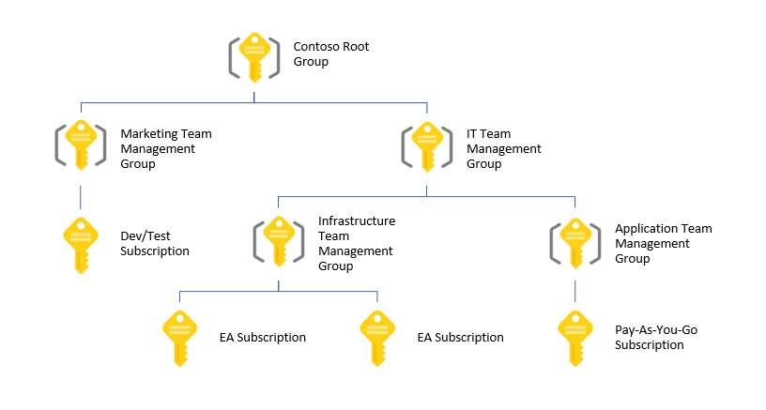
Management Groups
Provides a level of scope above subscriptions
Organizational alignment for your Azure subscriptions through custom hierarchies and grouping
Targeting of policies and spend budgets across subscriptions and inheritance down the hierarchies
Compliance and cost reporting by organization (business/teams)
Notes:
✔️ Management groups is a relatively new concept in Azure. Take time to review the reference links.
For more information, you can see:
Organize your resources with Azure management groups - https://docs.microsoft.com/en-us/azure/azure-resource-manager/management-groups-overview
Create management groups for resource organization and management - https://docs.microsoft.com/en-us/azure/azure-resource-manager/management-groups-create?toc=/azure/billing/TOC.json

Slide 11
Azure Subscriptions and Accounts
A subscription is a logical unit of Azure services that is linked to an Azure account
An account is an identity in Azure AD or in a directory that is trusted by Azure AD
Users,
groups, and service principles
Azure Active Directory
Authentication
& Authorization
Azure resources in resource groups
Azure Subscription(s)
Notes:
✔️ Do you know how many subscriptions your organization has? Do you know how resources are organized into resource groups?

Slide 12

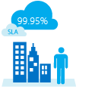


Getting an Azure Subscription
Enterprise Agreement
Reseller - Open Licensing program
Microsoft partner
Free trial account
Notes:
✔️ Which subscription model are you most interested in?
For more information, you can see:
Solution providers - https://www.microsoft.com/en-us/solution-providers/home

Slide 13
Controlling Access to Subscriptions
Administrative Role | Limit | Summary
Account Administrator | 1 per Azure account | Authorized to access the Account Center (create subscriptions, cancel subscriptions, change billing for a subscription, change Service Administrator, and more)
Service Administrator | 1 per Azure subscription | Authorized to access the Azure Management Portal for all subscriptions in the account. By default, same as the Account Administrator when a subscription is created.
Co-administrator | 200 per subscription | Same as the Service Administrator, but can’t change the association of subscriptions to Azure directories.

Slide 14
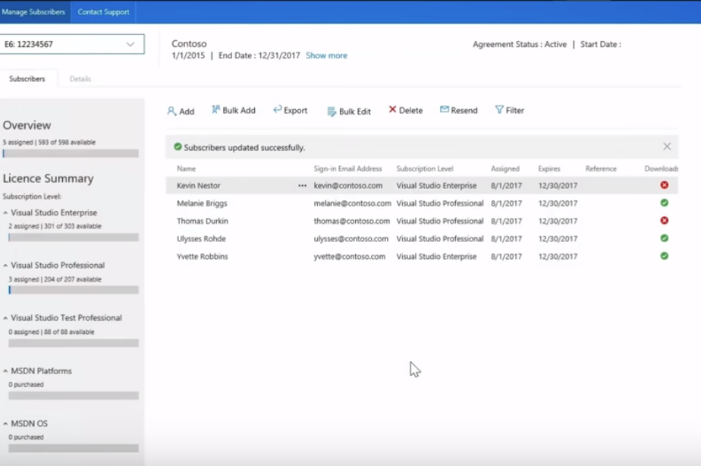
Visual Studio Administration Portal
Notes:
For more information, you can see:
https://visualstudio.microsoft.com/subscriptions-administration/

Slide 15
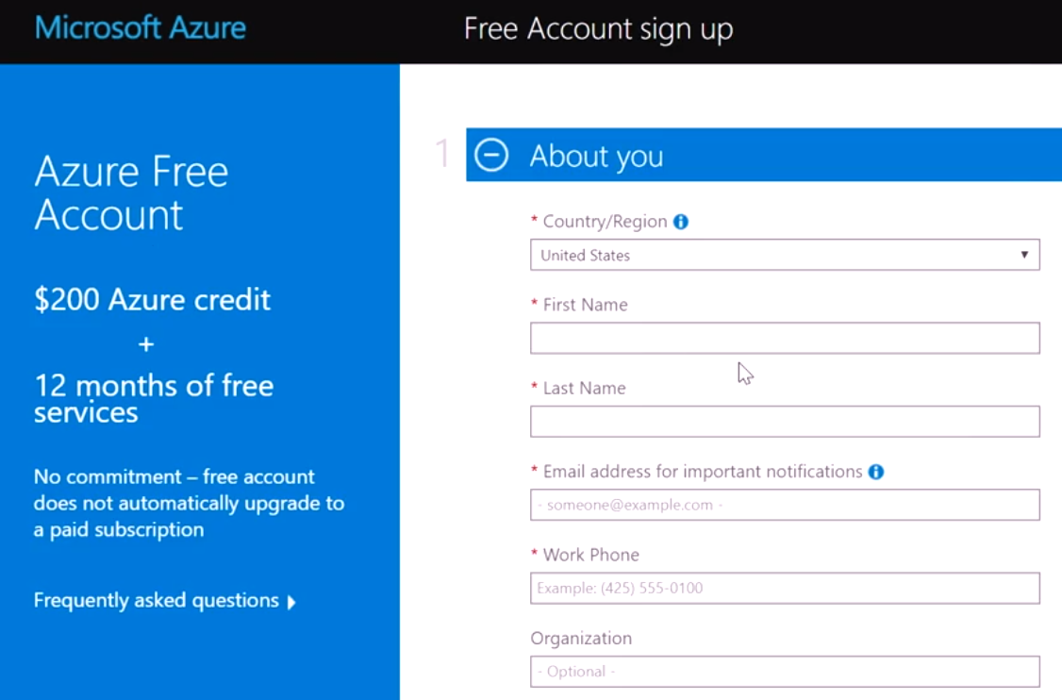
Azure Free Account

Slide 16
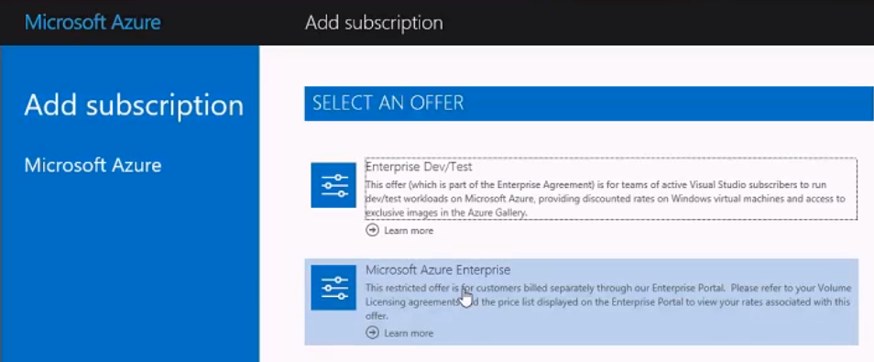
EA Dev/Test Subscriptions

Slide 17
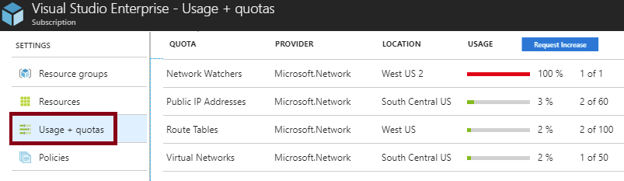
Check Resource Usage
All resources have a maximum limit listed in Azure limits
Helpful to track current usage, and plan for future use
You can request an increase
Notes:
✔You can also check your resource limits with PowerShell and the CLI. Learn more at the reference link. Be sure to review the limits page.
For more information, you can see:
Check resource usage against limits - https://docs.microsoft.com/en-us/azure/networking/check-usage-against-limits

Slide 18
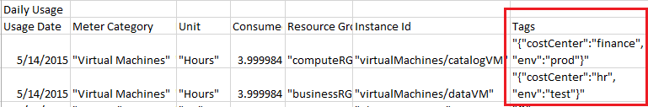
Tags
Tags logically organize your resources
Tags consist of a name and value
Useful especially in billing
Notes:
✔️ If you must create a lot of tags you will want to do that programmatically. You can use PowerShell or the CLI. Learn more at the reference links.
For more information, you can see:
Use tags to organize your Azure resources - https://docs.microsoft.com/en-us/azure/azure-resource-manager/resource-group-using-tags
PowerShell (Tagging) - https://docs.microsoft.com/en-us/azure/azure-resource-manager/resource-group-using-tags#powershell
CLI (Tagging) - https://docs.microsoft.com/en-us/azure/azure-resource-manager/resource-group-using-tags#azure-cli

Slide 19
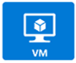
Enforcing Tags with Policy
Resource Group
Policy Script
Yes
Tag?
Create Resource
No
Request a Tag

Slide 20
Lesson 02: Billing

Slide 21
Available Roles
Application Administrator
Application Developer
Billing Administrator
Global Administrator
Password Administrator / Help Desk Administrator
Security Administrator
User Account Administrator
Notes:
✔️ Account Administrators using a Microsoft account must log in every 2 years (or more frequently) to keep the account active. Inactive accounts are cancelled, and the related subscriptions removed. There are no login requirements if using a work or school account. Take a few minutes to look through the list of available roles at the reference link.
For more information, you can see:
Assigning administrator roles in Azure Active Directory - https://docs.microsoft.com/en-us/azure/active-directory/users-groups-roles/directory-assign-admin-roles

Slide 22
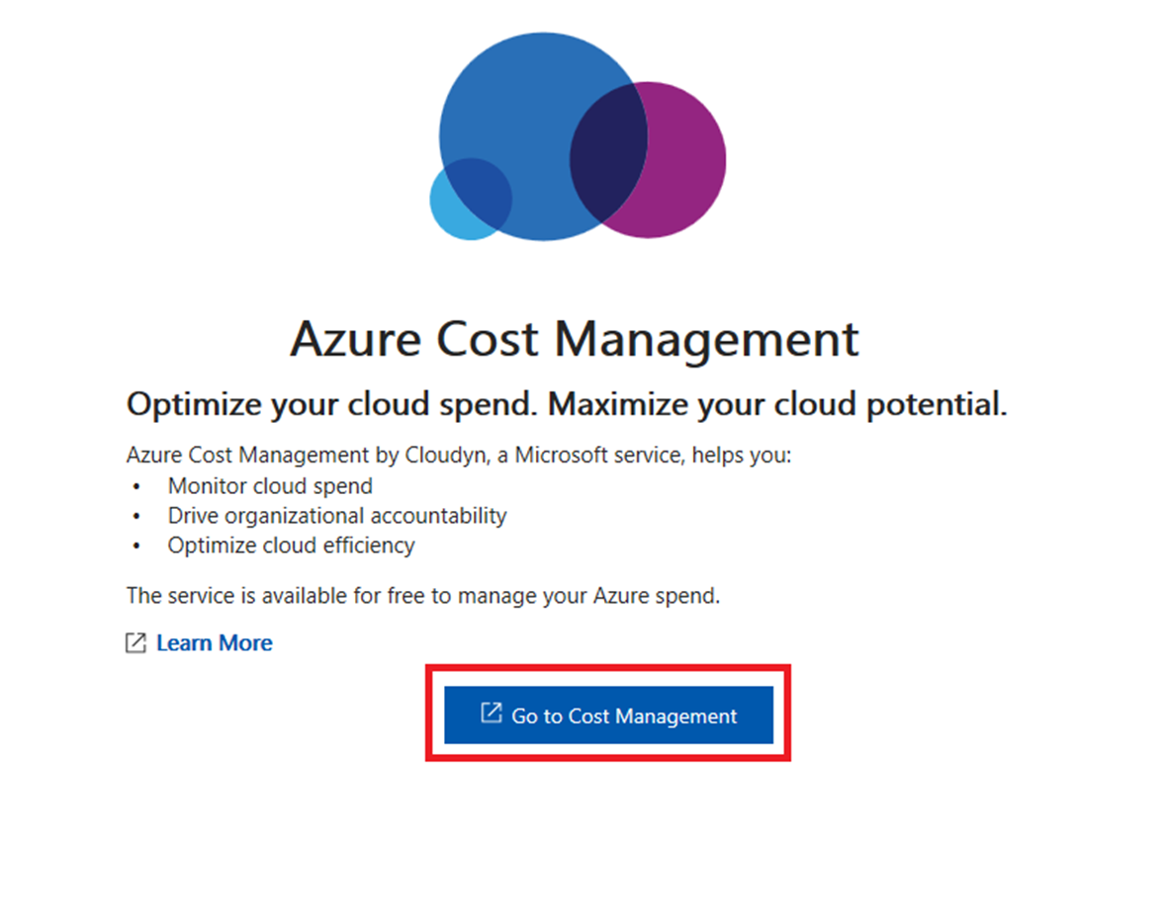
Billing
Get Resource usage data
Predict future costs
Set up billing alerts
Notes:
For more information, you can see:
Azure Cost Management Documentation - https://docs.microsoft.com/en-us/azure/cost-management/

Slide 23
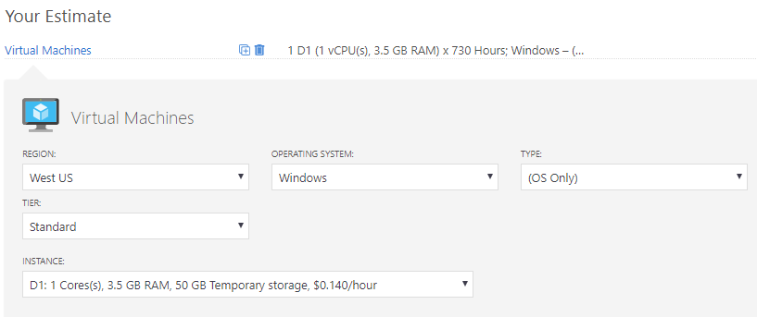
Pricing Calculator
Estimates in compute, networking, storage, web, and databases
Prices are estimates and are not intended as actual price quotes
Notes:
✔️ Take a few minutes to access the Pricing Calculator and try a few scenarios.
For more information, you can see:
Pricing Calculator - https://azure.microsoft.com/en-us/pricing/calculator/

Slide 24
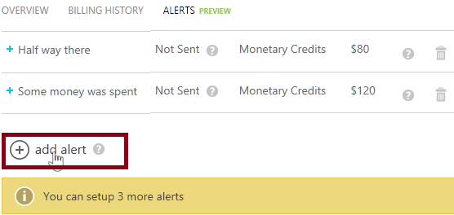
Billing Alert Service
Available to Account Administrators
Monitor and manage billing activity for your Azure accounts
Five billing alerts per subscription, two email recipients for each alert
Notes:
✔ EA subscriptions are not supported by this service, instead EA customers can get alerts for each department under an enrollment by setting spending quotas.
For more information, you can see:
Set up billing or credit alerts for your Microsoft Azure subscriptions - https://docs.microsoft.com/en-us/azure/billing/billing-set-up-alerts

Slide 25
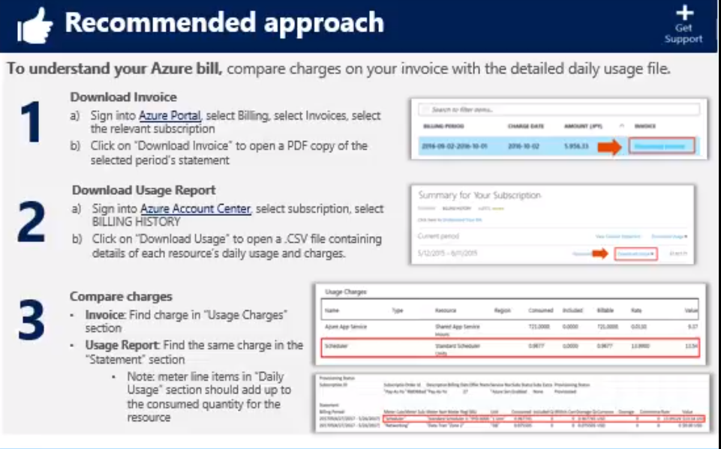
Understand Your Bill

Slide 26
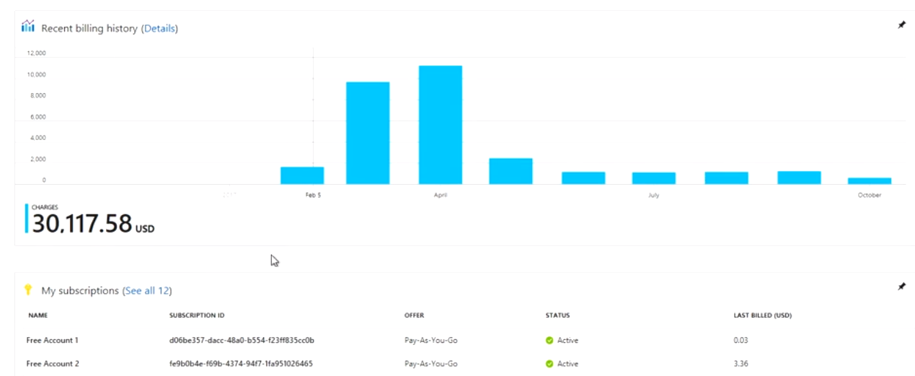
Azure Billing

Slide 27
Lesson 03: Azure Policy

Slide 28
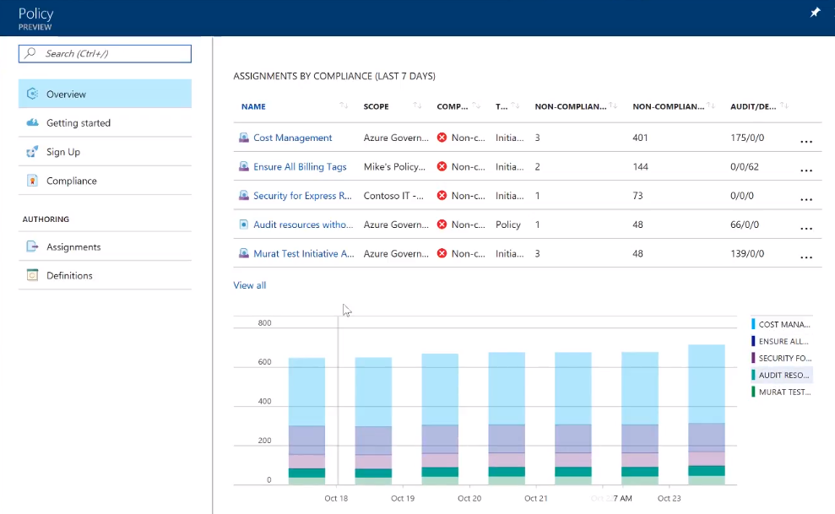
Azure Policy

Slide 29
Azure Policy
Azure Policy is a service in Azure that you use to create, assign and, manage policies
Azure Policy runs evaluations and scans for non-compliant resources
Advantages:
Enforcement and compliance
Apply policies at scale
Remediation
Notes:
For more information, you can see:
Azure Policy Documentation - https://docs.microsoft.com/azure/azure-policy/

Slide 30
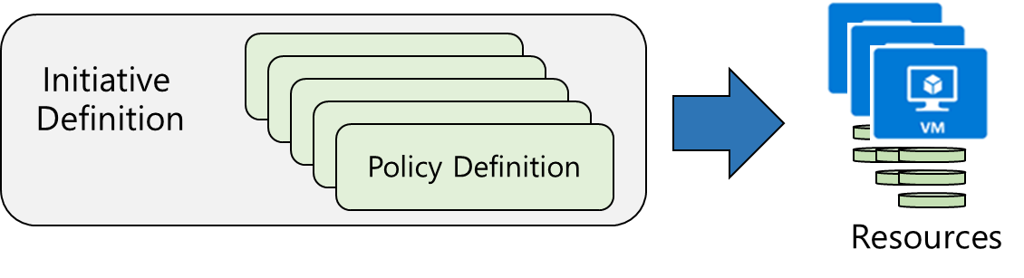
Implementing Azure Policies
Browse Policy Definitions
Create Initiative Definitions
Scope the Initiative Definition
View Policy evaluation results
Notes:
✔ Even if you have only a few Policy Definitions, we recommend creating an Initiative Definition. The next slides are the four steps on the slide.

Slide 31
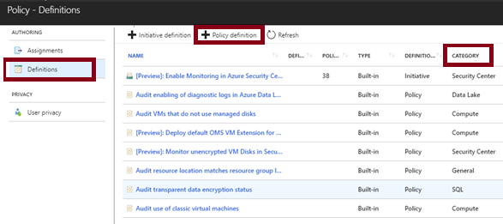
Browse Policy Definitions
Many policy definitions are available
You can import policies from GitHub
Policy Definitions have a specific JSON format
Notes:
✔️ Policy Definitions have a specific JSON format. As an Azure Administrator you will not need to create files in this format, but you may want to take a look so you are familiar. Review the available definitions in the portal and in GitHub.
For more information, you can see:
Policy Definition -
https://docs.microsoft.com/en-us/azure/azure-policy/azure-policy-introduction#policy-definition

Slide 32
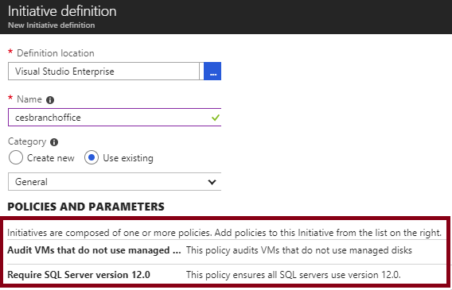
Create Initiative Definitions
Group policy definitions
Include one or more policies
Requires planning
Notes:
✔️ Can you see how this will require some planning to organize your policies?
For more information, you can see:
Initiative definition - https://docs.microsoft.com/en-us/azure/azure-policy/azure-policy-introduction#initiative-definition

Slide 33
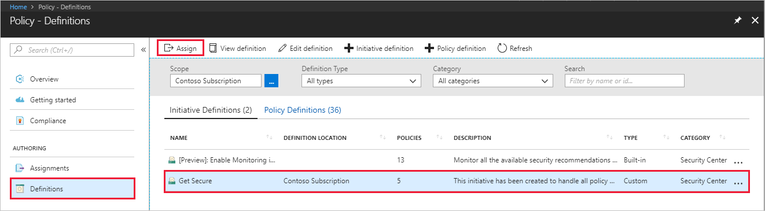
Scope the Initiative Definition
Assign the definition to a scope
The scope enforces the policy
Select the subscription, and optionally the resource group
Notes:
✔️ Currently, an Initiative Definition can have up to 100 policies.
For more information, you can see:
Initiative assignment - https://docs.microsoft.com/en-us/azure/azure-policy/azure-policy-introduction#initiative-assignment
Recommendations for managing policies - https://docs.microsoft.com/en-us/azure/azure-policy/azure-policy-introduction#recommendations-for-managing-policies

Slide 34
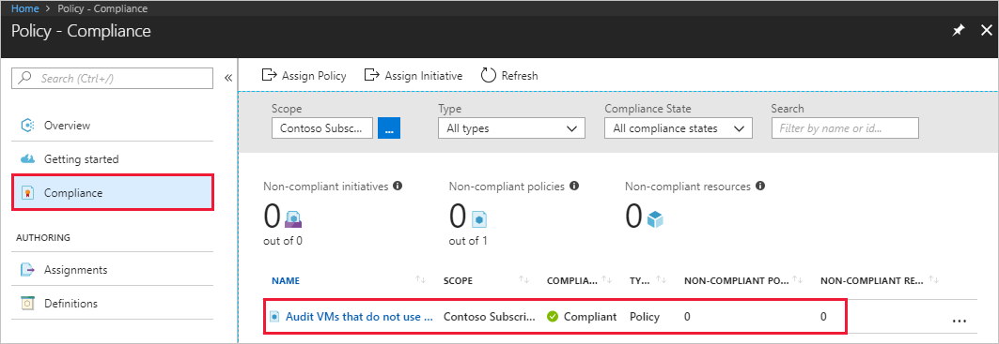
Determine Compliance
Non-compliant initiatives
Non-compliant policies
Non-compliant resources
Notes:
✔️ Policy evaluation happens about once an hour, which means that if you make changes to your policy definition and create a policy assignment then it will be re-evaluated over your resources within the hour.
For more information, you can see:
Identify non-compliant resources - https://docs.microsoft.com/en-us/azure/azure-policy/assign-policy-definition#identify-non-compliant-resources

Slide 35
Lab 1: View Your Bill
Download or view your Azure billing invoice and daily usage data
Get your invoice in email
Download an invoice from the Azure portal
Download usage from the Account Center
An invoice is only generated when you owe money. If you have a monthly credit amount or if you have a Free Trial, then you may not have an invoice.
Notes:
✔️ An invoice is only generated when you owe money. If you have a monthly credit amount or if you have a Free Trial, then you may not have an invoice.
For more information, you can see:
Understand terms on your Microsoft Azure invoice - https://docs.microsoft.com/en-us/azure/billing/billing-understand-your-invoice
Understand terms on your Microsoft Azure detailed usage charges - https://docs.microsoft.com/en-us/azure/billing/billing-understand-your-invoice#detailed-terms-and-descriptions-of-your-invoice

Slide 36
AZ-100.1 Module 02: Access Management for Cloud Resources

Slide 37
Lesson 01: Azure Users and Groups

Slide 38
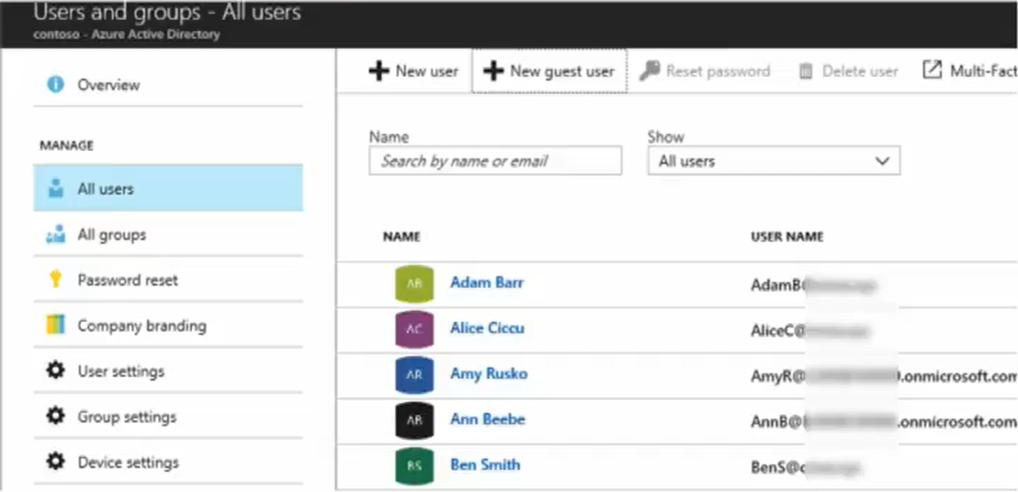
Managing Users and Groups

Slide 39
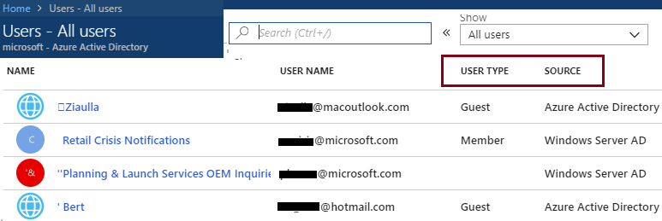
User Accounts
All users must have a user account
The account is used for authentication and authorization
Identity Sources: Cloud, Directory-synchronized, and Guest
Notes:
✔️ Take a minute to access the Portal and view your users. Notice the User Type and Source columns. Have you given any thought as to the type of users you will need?

Slide 40
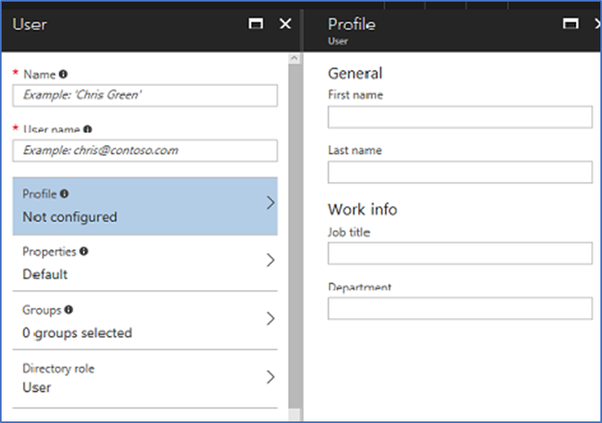
Adding User Accounts
# Create a password object
$PasswordProfile = New-Object -TypeName Microsoft.Open.AzureAD.Model.PasswordProfile
# Assign the password
$PasswordProfile.Password = "<Password>“
# Create the new user
New-AzureADUser -AccountEnabled $True -DisplayName "Abby Brown" -PasswordProfile $PasswordProfile -MailNickName "AbbyB" -UserPrincipalName AbbyB@contoso.com
Notes:
✔️ Users can also be added to Azure AD through Office 365 Admin Center, Microsoft Intune admin console, and the CLI. Which of the options mentioned in this topic do you prefer?
For more information, you can see:
Add or change profile information for a user in Azure Active Directory - https://docs.microsoft.com/en-us/azure/active-directory/active-directory-users-profile-azure-portal
Creating a new user in Azure AD - https://docs.microsoft.com/en-us/powershell/azure/active-directory/new-user-sample?view=azureadps-2.0
az ad user create - https://docs.microsoft.com/en-us/cli/azure/ad/user?view=azure-cli-latest#az_ad_user_create

Slide 41
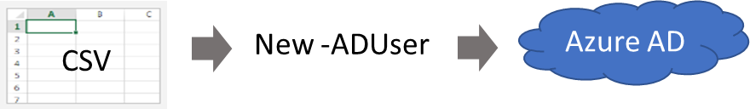
Bulk User Accounts
Use Connect-AzureAD to create a PowerShell connection to your directory
Create a new Password Profile for the new users
Use Import-CSV to import the csv file
Loop through the users in the file constructing the user parameters
Use New-ADUser to create each user
Be sure to enable each account
Notes:
✔️ Establish or implement a naming convention for usernames, display names and aliases. The password for the new users needs to conform to the password complexity rules you have set for your directory. User parameters include User Principal Name, Display Name, Given Name, Department, and Job Title.
For more information, you can see:
Importing data into my directory - https://docs.microsoft.com/en-us/powershell/azure/active-directory/importing-data?view=azureadps-2.0
New-ADUser - https://docs.microsoft.com/en-us/powershell/module/azuread/new-azureaduser?view=azureadps-2.0

Slide 42
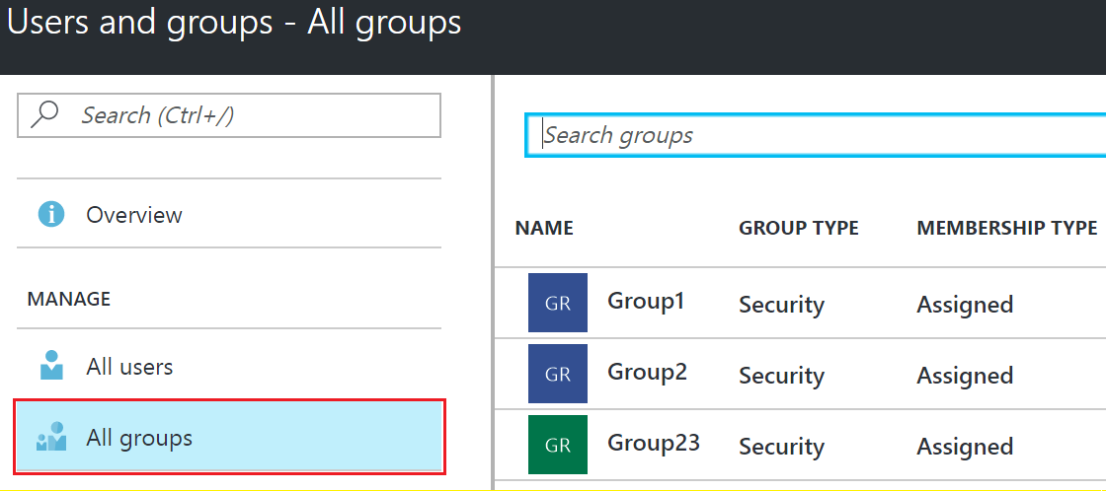
Group Accounts
Security groups
Distribution groups
Directly assigned
Dynamically assigned
New-AzureADGroup -Description "Marketing" -DisplayName "Marketing" -MailEnabled $false -SecurityEnabled $true -MailNickName "Marketing"
Notes:
✔️ Have you given any thought to which groups you need to create? Would you directly assign or dynamically assign membership?
For more information, you can see:
Manage group membership for users in your Azure Active Directory tenant - https://docs.microsoft.com/en-us/azure/active-directory/active-directory-groups-members-azure-portal
Create attribute-based rules for dynamic group membership in Azure Active Directory - https://docs.microsoft.com/en-us/azure/active-directory/active-directory-groups-dynamic-membership-azure-portal
Create a group and add members in Azure Active Directory - https://docs.microsoft.com/en-us/azure/active-directory/active-directory-groups-create-azure-portal
New-AzureADGroup - https://docs.microsoft.com/en-us/powershell/module/azuread/new-azureadgroup?view=azureadps-2.0

Slide 43
Lesson 02: Role-based Access Control

Slide 44
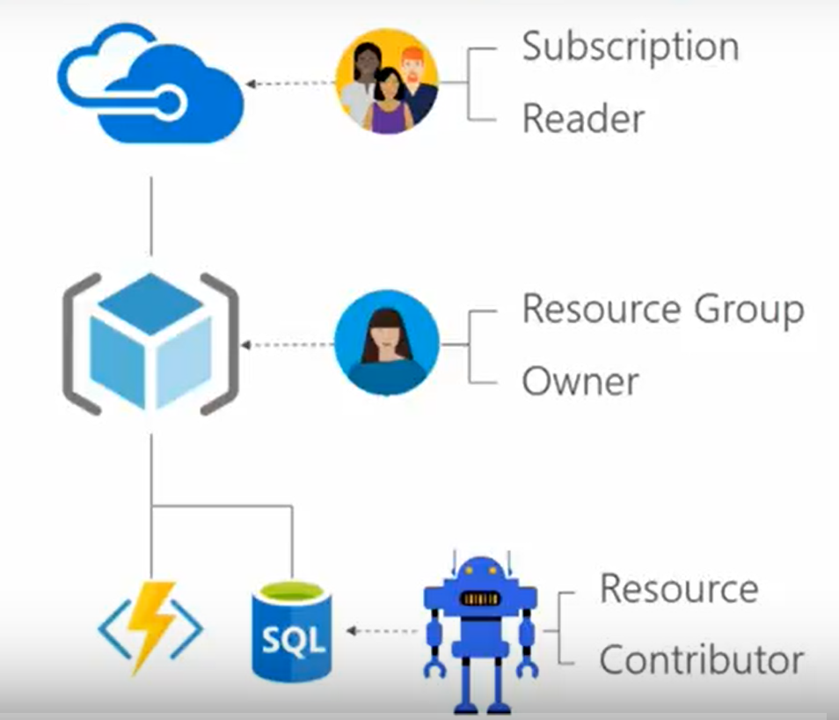
Role-Based Access Control

Slide 45
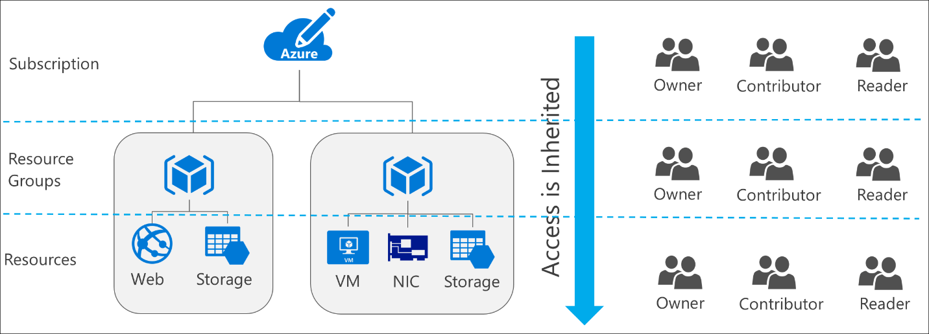
RBAC Concepts
Define what actions are allowed and/or denied
Associate the role with a user, group or service principal
Scope to a subscription, a resource group, or specific resources
Notes:
✔️ Take a minute to access the Portal and view your users. Notice the User Type and Source columns. Have you given any thought as to the type of users you will need?
✔️ Users and groups are sourced from Azure Active Directory, which is commonly populated with credentials from on-premises directories, such as Active Directory. Note that RBAC access that you grant at parent scopes is inherited at child scopes.
For more information, see:
Get started with access management in the Azure portal: https://docs.microsoft.com/en-us/azure/active-directory/role-based-access-control-what-is

Slide 46
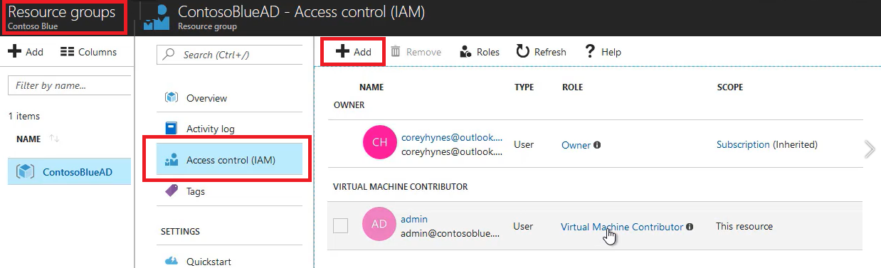
Roles
Owner can manage everything, including access
Contributors can manage everything except access
Readers can view everything but can't make changes

Slide 47
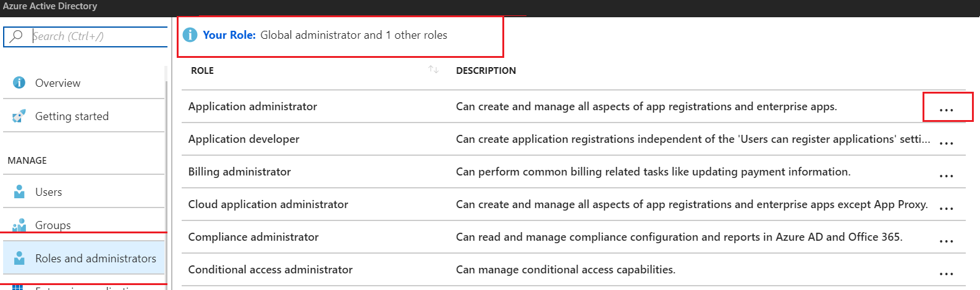
Administrator Permissions
Designate separate administrators for different functions
Global administrators can access all administrative features
Global administrators can assign other administrators
Notes:
✔Are you using the Azure forums to find information and post questions? If not, try the reference link.
For more information, you can see:
Assigning administrator roles in Azure Active Directory - https://docs.microsoft.com/en-us/azure/active-directory/users-groups-roles/directory-assign-admin-roles
Available roles - https://docs.microsoft.com/en-us/azure/active-directory/users-groups-roles/directory-assign-admin-roles#available-roles
Active Directory Forum - https://feedback.azure.com/forums/169401-azure-active-directory?category_id=166032

Slide 48
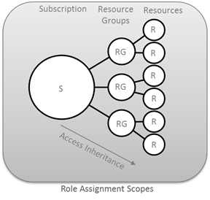
Resource Scope
Roles can be assigned for resources groups and individual resources
Resource inherits role assignments from its parent resources

Slide 49
Role Assignment
Users
Assigned to organizational users in the AD associated with the subscription
Or, external Microsoft accounts in the same directory
Groups
Assigned to Azure AD security groups
Best practice: manage access through groups, adding roles, and assigning users
Service Principals
Service identities represented as service principals in the directory
Authenticate with Azure AD and securely communicate with one another
Notes:
✔Explain the benefits of role assignment that allows you to associate a security principal to a role, and how this decoupling lets you specify a specific role has access to a resource in your subscription. Also to add/remove security principals in a loosely connected manner.

Slide 50
Role Definitions
Built-in Role | Action | NotActions
Owner (allow all actions) | *
Contributor (allow all actions except writing or deleting role assignment) | * | Microsoft.Authorization/*/Delete, Microsoft.Authorization/*/Write, Microsoft.Authorization/elevateAccess/Action
Reader (allow all read actions) | */read
Name : Owner
ID : 8e3af657-a8ff-443c-a75c-2fe8c4bcb65
IsCustom : False
Description : Manage everything, including access to resources
Actions : {*}
NotActions : {}
AssignableScopes : {/}
Notes:
✔️ Take a minute to open the Azure Portal, open the Subscriptions or Resource Group blade, and click Access Control (IAM).
Click Add and take a few minutes to review the built-in roles and see which role you would be most interested in using.
For more information, you can see:
Built-in roles in Azure - https://docs.microsoft.com/en-us/azure/role-based-access-control/built-in-roles
Create custom roles for Azure Role-Based Access Control - https://docs.microsoft.com/en-us/azure/active-directory/role-based-access-control-custom-roles
Get-AzureRmRoleDefinition - https://docs.microsoft.com/en-us/powershell/module/azurerm.resources/get-azurermroledefinition?view=azurermps-5.3.0

Slide 51
Assignable Scopes
You must properly scope your role
Example 1 - Make a role available for assignment in two subscriptions.
“/subscriptions/c276fc76-9cd4-44c9-99a7-4fd71546436e”, “/subscriptions/e91d47c4-76f3-4271-a796-21b4ecfe3624”
Example 2 - Make a role available for assignment only in the Network resource group.
“/subscriptions/c276fc76-9cd4-44c9-99a7-4fd71546436e/resourceGroups/Network”
Notes:
✔️ Take a minute to open the Azure Portal and use the Access Control blade to add a role and then assign it to a user. For your organization which role assignments would you need?
For more information, you can see:
Custom roles access control - https://docs.microsoft.com/en-us/azure/active-directory/role-based-access-control-custom-roles#custom-roles-access-control

Slide 52
Demo RBAC
(Azure Portal) Grant access for a user using RBAC
Create a resource group
Assign a user to a role
Remove the role assignment
Notes:
For more information, you can see:
What is role-based access control - https://docs.microsoft.com/en-us/azure/role-based-access-control/overview

Slide 53
Enterprise Administrators
Enterprise Enrollment
Department A
Department B
Account A
Account B
Account C
Subscription 1
Subscription 2
Subscription 3
Subscription 4

Slide 54
Lab 2: Users and Groups
Work with users and groups in your Active Directory
Add new users
Manage group membership
Create a group and add members
Manage profile information
Notes:
✔️ For the Quickstarts in this practice, you will to sign in to Azure with an account that’s a global admin for the directory.
✔️As you have time, experiment with other user and group administrative tasks. Also, if you want to try some of these tasks using PowerShell, see the Azure Active Directory PowerShell 2.0 cmdlet reference for AzureAD (https://docs.microsoft.com/en-us/powershell/module/Azuread/?view=azureadps-2.0)

Slide 55
AZ-100.1 Module 03: Monitoring and Diagnostics

Slide 56
Lesson 01: Exploring Monitoring Capabilities in Azure

Slide 57
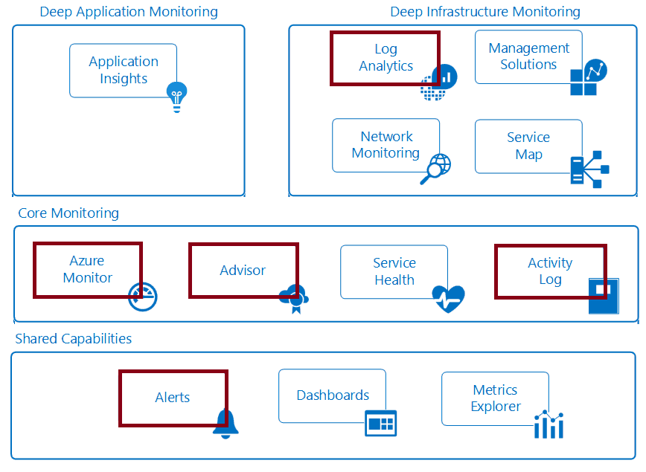
Introducing Azure Monitor Service
Notes:
✔ In this course we will cover the services that will help you with materials in the other courses. Specifically, the highlighted items in the diagram are covered in this course.
For more information, you can see:
Monitoring Azure applications and resources - https://docs.microsoft.com/en-us/azure/monitoring-and-diagnostics/monitoring-overview

Slide 58
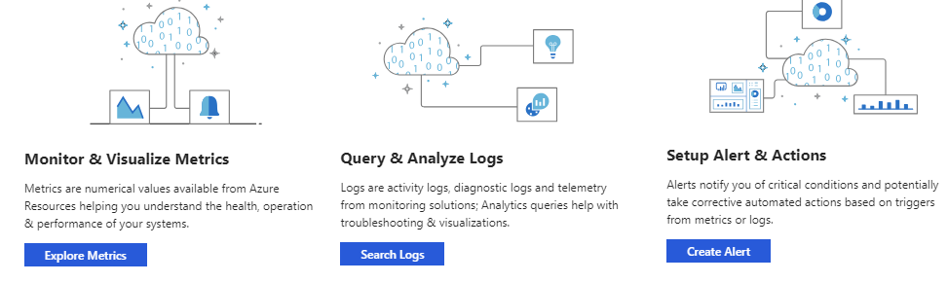
Azure Monitor: Key Capabilities
Core monitoring for Azure services
Collects metrics, activity logs, and diagnostic logs
Use for time critical alerts and notifications
Notes:
For more information, see:
Get started with Azure Monitor – https://docs.microsoft.com/en-us/azure/monitoring-and-diagnostics/monitoring-get-started

Slide 59
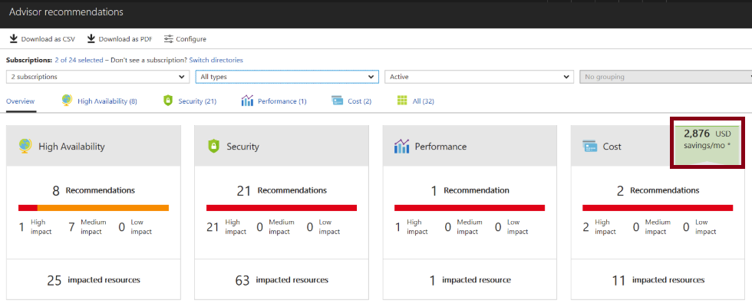
Azure Advisor
Personalized cloud consultant
Analyzes your configuration and recommends solutions
Four areas: High Availability, Security, Performance, and Cost
Notes:
✔ Advisor provides recommendations for virtual machines, availability sets, application gateways, App Services, SQL servers, and Redis Cache.
For more information, you can see:
Introduction to Azure Advisor - https://docs.microsoft.com/en-us/azure/advisor/advisor-overview
Advisor Cost recommendations - https://docs.microsoft.com/en-us/azure/advisor/advisor-cost-recommendations

Slide 60
Lesson 02: Azure Alerts

Slide 61
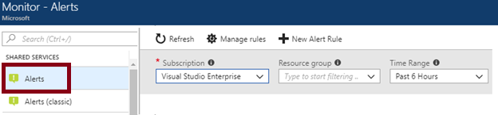
Azure Monitor Alerts
A unified authoring experience
Better creation workflow and fired alert notification
Consolidation into one view
Notes:
For more information, you can see:
The new alerts experience in Azure Monitor - https://docs.microsoft.com/en-us/azure/monitoring-and-diagnostics/monitoring-overview-unified-alerts

Slide 62
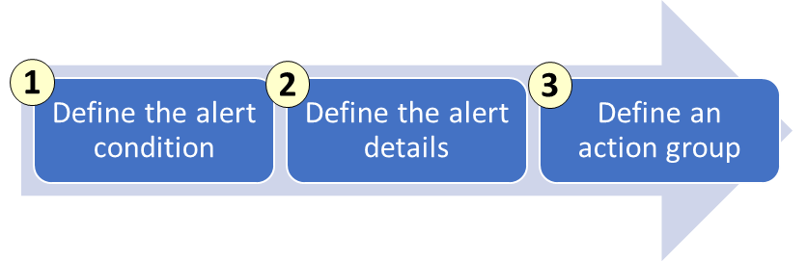
Creating Alert Rules
Define the alert condition with target, criteria, and logic
Define the alert details like rule name, description, and severity
Define the action group for notifications
Notes:
✔ Take a few minutes to create an alert rule and look at the options. Action groups are on the next slide.
For more information, you can see:
The new alerts experience in Azure Monitor - https://docs.microsoft.com/en-us/azure/monitoring-and-diagnostics/monitoring-overview-unified-alerts

Slide 63
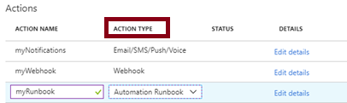
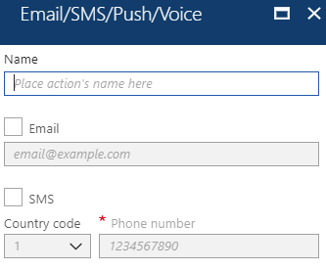
Action Groups
Configure a list of actions to take when the alert is triggered
Ensures the same actions are taken each time an alert is triggered
Action types: Email/SMS/Push/Voice, Logic App, Webhook, IT Service Management, or Automation Runbook
Notes:
✔ Take a few minutes to create an action group using the link below.
For more information, you can see:
Create an action group by using the Azure portal - https://docs.microsoft.com/en-us/azure/monitoring-and-diagnostics/monitoring-action-groups#create-an-action-group-by-using-the-azure-portal
Action specific information - https://docs.microsoft.com/en-us/azure/monitoring-and-diagnostics/monitoring-action-groups#action-specific-information
Rate limiting for Voice, SMS, emails, Azure App push notifications and webhook posts - https://docs.microsoft.com/en-us/azure/monitoring-and-diagnostics/monitoring-alerts-rate-limiting

Slide 64
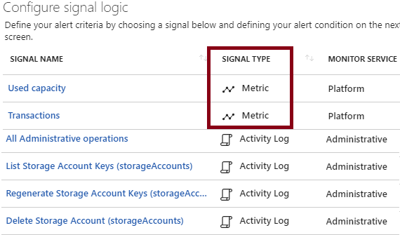
Signal Types and Metrics
Improved latency
Support for multi-dimensional metrics
More control over metric conditions
Combined monitoring of multiple metrics
Metrics from Logs
Notes:
For more information, you can see:
Alert rule terminology - https://docs.microsoft.com/en-us/azure/monitoring-and-diagnostics/monitoring-overview-unified-alerts#alert-rules-terminology

Slide 65
Lab 3A: Alerts
Audit and receive notifications about important actions in your Azure subscription
Create a network security group
Browse the Activity Log in the portal
Browse an event in the Activity log
Notes:
✔ Can you see how the activity log lets you monitor activity at the subscription level? If you like, try another practice using the reference link.
For more information, you can see:
Create, view, and manage alerts using Azure Monitor - https://docs.microsoft.com/en-us/azure/monitoring-and-diagnostics/monitor-alerts-unified-usage

Slide 66
Lesson 03: Azure Activity Log

Slide 67
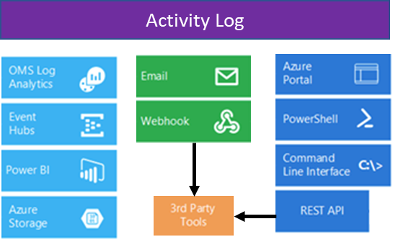
Overview of Activity Log
Send data to Log Analytics for advanced search and alerts
Query or manage events in the Portal, PowerShell, CLI, and REST API
Stream information to Event Hub
Archive data to a storage account
Analyze data with Power BI
Notes:
✔ The Activity Log differs from Diagnostic Logs (https://docs.microsoft.com/en-us/azure/monitoring-and-diagnostics/monitoring-overview-of-diagnostic-logs). Activity Logs provide data about the operations on a resource from the outside (the "control plane"). Diagnostics Logs are emitted by a resource and provide information about the operation of that resource (the "data plane").
For more information, you can see:
Monitor Subscription Activity with the Azure Activity Log - https://docs.microsoft.com/en-us/azure/monitoring-and-diagnostics/monitoring-overview-activity-logs

Slide 68
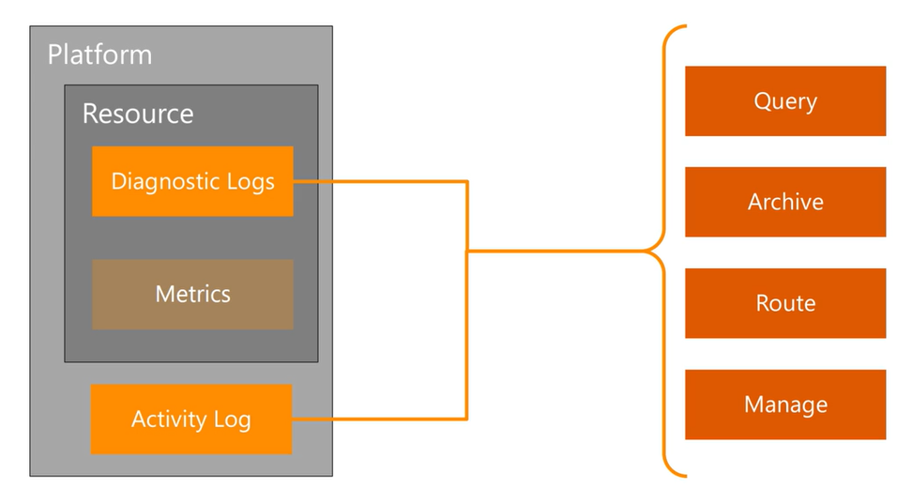
Activity Log
Notes:
✔ You can think of Azure Monitor as a platform service which provides a pipeline for metric and log data coming from any Azure resource providers. Alerts and Activity Log are covered in more details in separate lessons. Log Analytics is covered in a separate module.

Slide 69
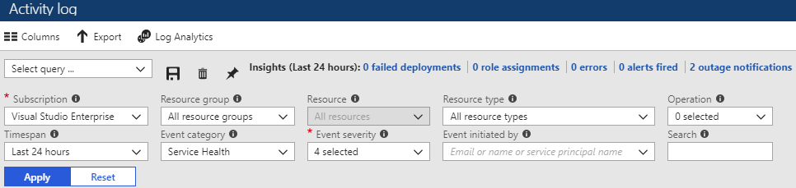
Query the Activity Log
Filter by: Subscription, Resource group, Resource (name), Resource type, Operation name, Timespan, Category, Severity, and Event initiated by
Notes:
✔ Once you have defined a set of filters, you can save it as a query that is persisted across sessions if you ever need to perform the same query with those filters applied again in the future. You can also pin a query to your Azure dashboard to always keep an eye on specific events.
For more information, you can see:
Query the Activity Log in the Azure portal - https://docs.microsoft.com/en-us/azure/monitoring-and-diagnostics/monitoring-overview-activity-logs#query-the-activity-log-in-the-azure-portal

Slide 70
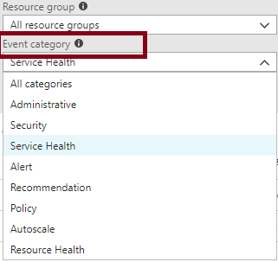
Event Categories
Administrative events
Service health events with status
Alert events
Autoscale events
Usage recommendations
Security events
Policy and Resource Health (reserved)
Notes:
For more information, you can see:
Categories in the Activity Log - https://docs.microsoft.com/en-us/azure/monitoring-and-diagnostics/monitoring-overview-activity-logs#categories-in-the-activity-log

Slide 71
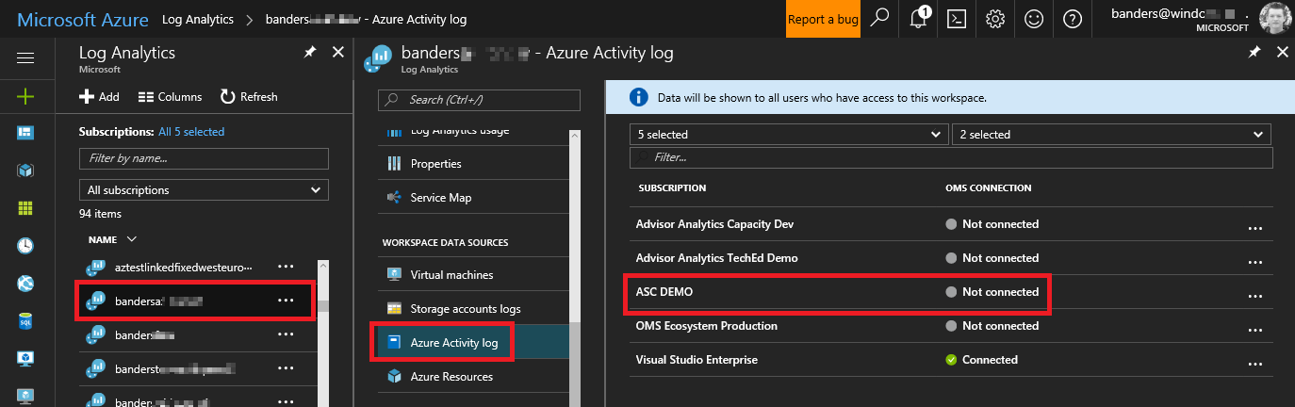
Activity Log and Log Analytics
Analyze the activity logs with pre-defined views
Analyze and search activity logs from multiple Azure subscriptions
See operational activities aggregated by status
View trends of activities happening on each of your Azure services
Notes:
✔ Log Analytics collects activity logs and stores the logs for 90 days free of charge. If you store logs for longer than 90 days, you will incur data retention charges for the data stored longer than that period. When you're on the Free pricing tier, activity logs do not apply to your daily data consumption. The next module is Log Analytics.
For more information, you can see:
Collect and analyze Azure activity logs in Log Analytics - https://docs.microsoft.com/en-us/azure/log-analytics/log-analytics-activity

Slide 72
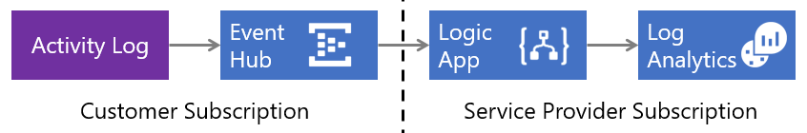
Collect Across Subscriptions
Low latency and minimal coding
Azure Activity Log sends events to an Event Hub where a Logic App sends them to your Log Analytics workspace
Notes:
✔ Do you think your organization would benefit from this strategy?
For more information, you can see:
Collect Azure Activity Logs into Log Analytics across subscriptions - https://docs.microsoft.com/en-us/azure/log-analytics/log-analytics-activity-logs-subscriptions

Slide 73
Lab 3B: Activity Log
Configure activity logs in the Azure portal
Create an activity log alert
View the Activity Log in the Azure portal
Configure log profiles using the Azure portal
Notes:
✔️ The tasks listed are only a representative sampling of what you can do with Activity Logs. Explore some of the other tasks as you have time. Don’t forget to view the associated Activity Log dashboards. (Click the Azure Activity Logs tile to open the Azure Activity Logs dashboard.) Try some PowerShell and CLI tasks.
For more information, see:
Create activity log alerts – https://docs.microsoft.com/en-us/azure/monitoring-and-diagnostics/monitoring-activity-log-alerts
Stream the Azure Activity Log to Event Hubs – https://docs.microsoft.com/en-us/azure/monitoring-and-diagnostics/monitoring-stream-activity-logs-event-hubs
Archive the Azure Activity Log – https://docs.microsoft.com/en-us/azure/monitoring-and-diagnostics/monitoring-archive-activity-log
Collect and analyze Azure activity logs in Log Analytics - https://docs.microsoft.com/en-us/azure/log-analytics/log-analytics-activity

Slide 74
AZ-100.1 Module 04: Log Analytics

Slide 75
Lesson 01: Introduction to Log Analytics

Slide 76
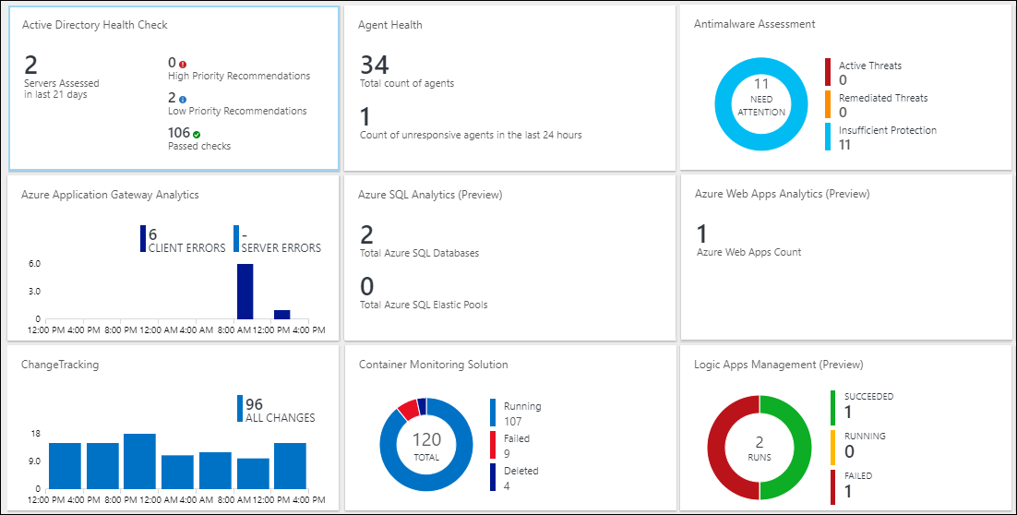
Log Analytics
Notes:
✔ Log Analytics helps you collect, correlate, search, and act on log and performance data generated by operating systems and applications. It gives you real-time operational insights using integrated search and custom dashboards to readily analyze millions of records across all your workloads and servers regardless of their physical location. Log Analytics gives you a single interface for consuming and correlating the data, covering both Linux and Windows Server.

Slide 77
Log Analytics Scenarios
Example 1 - Assessing updates
IT Administrators assess systems update requirements
Must be able to accurately schedule updates
OMS/Log Analytics collects data from all customers performing updates
Uses "Crowd-sourced" data to provide an average time to help meet strict SLAs
Example 2 - Change tracking
Troubleshooting operational incidents is a complex process
OMS/Log Analytics let you perform analysis from multiple angles, using a variety of sources
Everything correlated through a single interface
Track issues such as unexpected system reboots or shutdowns
Notes:
For more information, you can see:
‎What is Log Analytics? https://docs.microsoft.com/en-us/azure/log-analytics/log-analytics-overview
What’s new in Microsoft Operations Management Suite: Log Analytics - https://blog.tyang.org/wp-content/uploads/2016/04/Whats-New-in-OMS.pdf
Log Analytics FAQ - https://azure.microsoft.com/en-us/services/log-analytics/faq/
Unified Alerts in Log Analytics - https://docs.microsoft.com/en-us/azure/log-analytics/log-analytics-alerts

Slide 78
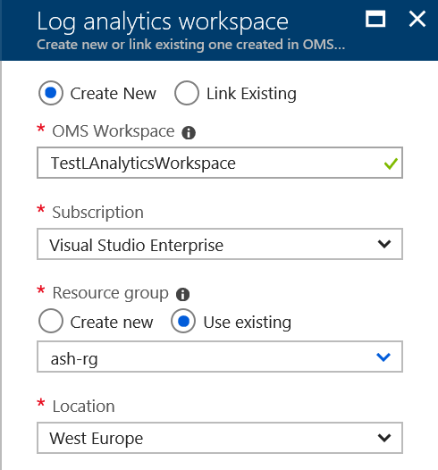
Create a Workspace
A workspace is an Azure resource and is a container where data is collected, aggregated, analyzed, and presented
You can have multiple workspaces per Azure subscription and you can have access to more than one workspace
A workspace provides a geographic location, data isolation, and scope
Notes:
For more information, see:
Create a Workspace – https://docs.microsoft.com/en-us/azure/log-analytics/log-analytics-quick-collect-azurevm#create-a-workspace

Slide 79
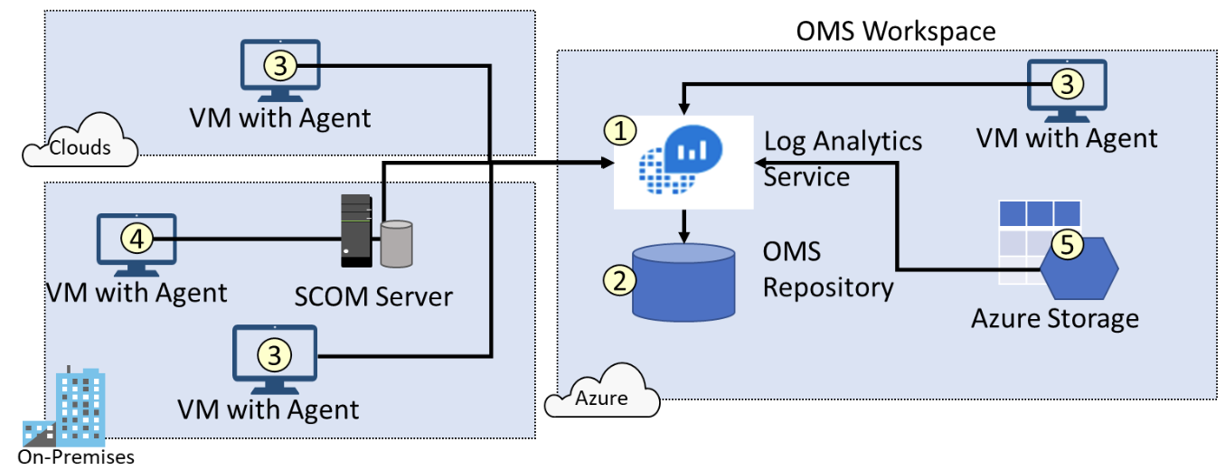
Connected Sources
Connected sources generate data
Data can be collected from Windows, Linux, SCOM and Azure Storage
Notes:
For more information, you can see:
Connecting Computers to the Log Analytics Service - https://docs.microsoft.com/en-us/azure/log-analytics/log-analytics-windows-agents#system-requirements-and-required-configuration

Slide 80
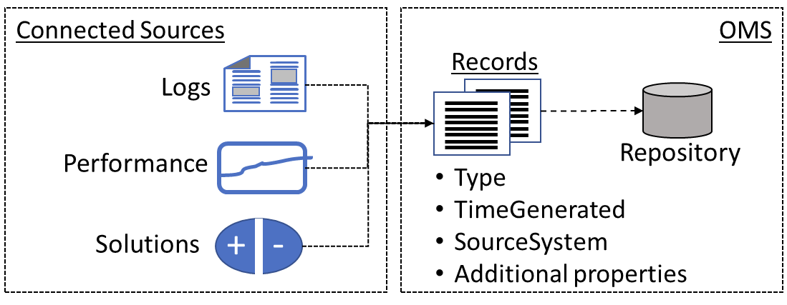
Data Sources
Data sources include: Windows Event Logs, Windows Performance Counters, Linux Performance Counters, IIS Logs, Custom Fields, Custom Logs, and Syslog.
Each data source has additional configuration options.
Notes:
For more information, you can see:
Data Sources in Log Analytics - https://docs.microsoft.com/en-us/azure/log-analytics/log-analytics-data-sources

Slide 81
Lab 4A: Visualize Data
Create a Log Analytics dashboard and add log search
Create a shared dashboard in the Azure portal
Visualize a performance log search
Add a log search to a shared dashboard
Customize the dashboard
Notes:
✔️ In this tutorial, you learned how to create a dashboard in the Azure portal and add a log search to it. In the next tutorial you will learn the different responses you can implement based on log search results.

Slide 82
Lab 4 B: Alert on Data
Respond to events with Azure Monitor alerts
Create an alert based on a Log Analytics workspace
Configure an Action Group to send an email notification
Notes:
✔️ In this tutorial, you learned to create an alert based on your Log Analytics workspace and then defined a custom log search. You then activated your alert and created an Action Group to send an email notification each time the alert is triggered.

Slide 83
Lesson 02: Querying and Analyzing Log Analytics Data

Slide 84
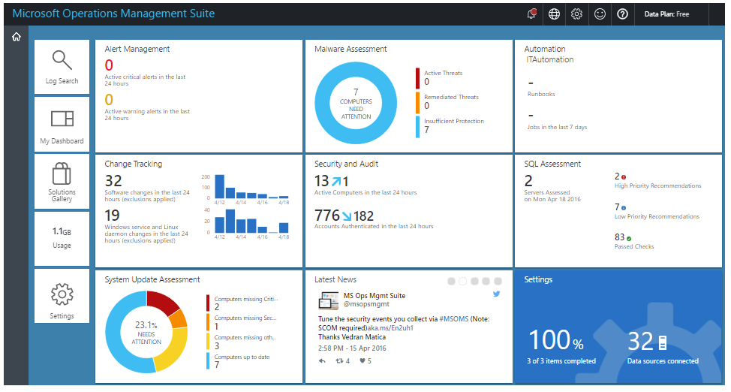
Analyzing Log Analytics Data
Leverage log searches, construct queries, customize views
OMS portal capabilities are moving to the Azure portal
Notes:
✔ In response to customer feedback to consolidate monitoring and management of both on premises and Azure workloads into a single user experience, OMS portal capabilities have been added into the Azure portal.
For more information, you can see:
OMS portal moving to Azure – https://docs.microsoft.com/en-us/azure/log-analytics/log-analytics-oms-portal-transition

Slide 85
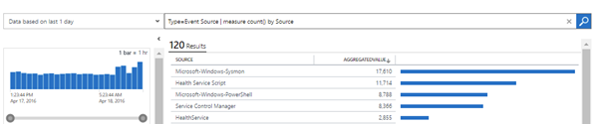
Log Analytics Querying
Log Analytics provides a query syntax
Quickly retrieve and consolidate data in the repository
Save or have log searches run automatically to create an alert
Export the data to Power BI or Excel
Notes:
For more information, you can see:
Azure Log Analytics – meet our new query language - https://azure.microsoft.com/en-us/blog/azure-log-analytics-meet-our-new-query-language-2/

Slide 86

Query Language Syntax
Event
| where (EventLevelName == "Error")
| where (TimeGenerated > ago(1days))
| summarize ErrorCount = count() by Computer
| top 10 by ErrorCount desc
Notes:
✔ You can try this query and many others during the Practice: Log Analytics Queries.
For more information, you can see:
Understanding log searches in Log Analytics - https://docs.microsoft.com/en-us/azure/log-analytics/log-analytics-log-search

Slide 87
Lab 5 : Analysis with Log Analytics
Microsoft Online Labs has a self-paced Deep Analysis with Microsoft Azure Log Analytics exercise.
Focus on the basics of Azure Insight and Analytics
Explore Log Analytics, log searches, analysis of Service Map and Network Performance Monitor solutions
Notes:
Microsoft Online Labs - https://www.microsoft.com/handsonlabs/SelfPacedLabs

Slide 88
AZ-100.1 Module 05: Azure Resource Manager

Slide 89
Lesson 01: Resource Groups

Slide 90

Azure Resource Manager
A resource is simply a single service instance in Azure
A resource group is a logical grouping of resources
A resource group template is a JSON file that allows you to declaratively describe a set of resources
Notes:
For more information, you can see:
Azure Resource Manager - https://docs.microsoft.com/en-us/azure/azure-resource-manager/resource-group-overview

Slide 91

ARM Template Advantages
Ensures idempotency
Simplifies orchestration
Configure multiple resources simultaneously
Use variables/parameters/functions to create dependencies
Can be configured and managed using a source control provider
Reusable and nestable
Notes:
For more information, see:
Create a Workspace – https://docs.microsoft.com/en-us/azure/log-analytics/log-analytics-quick-collect-azurevm#create-a-workspace

Slide 92
Lesson 02: Resource Groups

Slide 93





Resource Groups and Deployments
Resources can only exist in one resource group
Groups cannot be renamed
Groups can have resources of many different types (services)
Groups can have resources from many different regions
Deployments are incremental

Slide 94

Resource Manager Locks
Associate the lock with a subscription, resource group, or resource
Locks are inherited by child resources
Read-Only locks prevent any changes to the resource.
Delete locks prevent deletion
Notes:
✔ Only Owner and User Access Administrator roles can create or delete management locks.
For additional information, see:
Lock resources to prevent unexpected changes: https://docs.microsoft.com/en-us/azure/azure-resource-manager/resource-group-lock-resources

Slide 95


Moving Resources
When moving resources, both the source group and the target group are locked during the operation
Services that can be moved
Services that cannot be moved
Notes:
✔ Just because a service can be moved doesn’t mean there aren’t restrictions. For example, you can move a virtual network, but you must also move its dependent resources, like gateways. Learn more at the reference link.
For more information, you can see:
Move resources to new resource group or subscription - https://docs.microsoft.com/en-us/azure/azure-resource-manager/resource-group-move-resources

Slide 96

Remove Resource Groups and Resources
Resource Groups
Remove-AzureRmResourceGroup -Name "ContosoRG01"
Resources
Remove-AzureRmResource -ResourceId “ "

Slide 97
Lab 5A: Deploy an ARM Template
Deploy an ARM template using PowerShell
Launch the Azure Cloud Shell
Create a resource group
Create the template files to deploy resources
Create a storage account and upload files
Deploy the template
Notes:
✔ Don’t worry about having to type the ARM template JSON code. Simply use the copy functionality that is provided in the exercise.
For more information, you can see:
Azure Resource Manager overview – https://docs.microsoft.com/en-us/azure/azure-resource-manager/resource-group-overview?toc=%2fazure%2fvirtual-machines%2fwindows%2ftoc.json
Troubleshoot common ARM deployment errors – https://docs.microsoft.com/en-us/azure/azure-resource-manager/resource-manager-common-deployment-errors

Slide 98
Lab 5 B: Lock Resources
Lock resources to prevent unexpected changes
Add a lock for a resource using the Azure portal
Use PowerShell to
Deploy the example template
Get information about all locks on resources and resource groups
Delete a lock
Notes:
✔ To create or delete management locks, you must have access to Microsoft.Authorization/* or Microsoft.Authorization/locks/* actions. Of the built-in roles, only Owner and User Access Administrator are granted those actions.
✔ You can also perform the same exercise with the Azure CLI if you prefer - https://docs.microsoft.com/en-us/azure/azure-resource-manager/resource-group-lock-resources#azure-cli
For more information, you can see:
Lock resources to prevent unexpected changes - https://docs.microsoft.com/en-us/azure/azure-resource-manager/resource-group-lock-resources

Slide 99
AZ-100.1 Module 06: Azure Tips, Tricks, and Tools

Slide 100
Lesson 01: The Azure Portal
Notes:
This module is a set of video walkthroughs that cover helpful ways to navigate the Azure portal as well as a general review of the environment and key tools.
In addition, the module provides videos of important tools that an admin would use in their day to day job, such as PowerShell and the command line interface (CLI).
Depending upon how familiar your students are with Azure, you may opt to ignore this module. Or you could recommend it to students to watch after class if they need a refresher on the basics of the Azure portal, or how to work in the Cloud Shell.
You can definitely consider this as optional material if you need to make adjustments in your time management of a particular class.

Slide 101

Portal Themes
Choose from a set of predefined themes in the Azure portal
High contrast themes for accessibility
Change your theme with a simple double-click on the dashboard
Notes:
✔ This video and the next ones are courtesy of Michael Crump in the Azure Product team. We are highlighting just a few of the many tips and tricks videos available on his blog. Be sure to check out the complete list.
Azure Tips and Tricks - The Complete List - https://www.michaelcrump.net/azure-tips-and-tricks-complete-list/

Slide 102

Customize the Dashboard
Notes:
✔ This video and the next ones are courtesy of Michael Crump in the Azure Product team. We are highlighting just a few of the many tips and tricks videos available on his blog. Be sure to check out the complete list.
Azure Tips and Tricks - The Complete List - https://www.michaelcrump.net/azure-tips-and-tricks-complete-list/

Slide 103
Lesson 02: Azure Tools and Environment

Slide 104
Azure CLI
Command-line tool alongside Azure PowerShell
Focused on Mac/Linux/BASH/cmd.exe
Simple to automate
Easy to learn
Notes:
For more information, you can see:
Get started with Azure CLI 2.0 - https://docs.microsoft.com/en-us/cli/azure/get-started-with-azure-cli?view=azure-cli-latest

Slide 105
Azure PowerShell
Set of cmdlets that use Azure Resource Manager to manage resources
Use locally or with the Azure Cloud Shell
Update Azure PowerShell installation with Update-Module
Use multiple versions of Azure PowerShell if needed
Install an older version
# Install version 1.2.9 of Azure PowerShell Install-Module -Name AzureRM -RequiredVersion 1.2.9
Load a different version (Latest version provided by default when loading)
# load version 1.2.9 of Azure PowerShell Import-Module -Name AzureRM -RequiredVersion 1.2.9
Notes:
For more information, you can see:
Azure PowerShell - https://docs.microsoft.com/en-us/powershell/azure/overview?view=azurermps-6.5.0

Slide 106
Azure PowerShell Cross-Platform
Run PowerShell on Linux and Mac systems
PowerShell is now PowerShell Core 6
Built on .NET, PowerShell modules converted to .Net Core

Slide 107

Resource Explorer
Standalone app for working with Azure Storage data on Windows, Mac OS, and Linux
Connect and manage your storage accounts
Notes:
There are no module review questions for this module.

